Slide 1



Department of Computer Science and Engineering
Project Phase – II (17CSP85)
Review – 2
Chrome Extension for Dropdown Code Editor
Group No.: G1 Batch No.: 25
1KS17CS012 ARITRA RAY
1KS17CS073 SAURAV SUMAN
1KS17CS080 SOUVIK MANDAL
Guided By:
Mrs. Geetha R.
Assistant Professor

Slide 2
Introduction
Extensions are small bits of software that allow you to customize the look and feel of your browser. HTML, CSS, and JavaScript can be used to customize Chrome's functionality and behaviour.
While any application or software can create timetables, to-do lists, and set notifications, Chrome extensions make it easy to keep organized while browsing the web.
This project “Chrome Extension for online code editor” will provide the features of an online code editor as an chrome extension.

Slide 3
Contents
Introduction
Problem Statement and Objectives
Methodology Proposed/ Design
Technologies / Tools Used
Implementation of Modules with codes
Results
Snapshots
References

Slide 4
Problem Statement and Objectives
1. Problem Statement
The user needs to visit online editors or download external IDEs for verification.
The problem with this is that external IDEs require space and sometimes come with ads.
Also, there is a risk of installing and exposing your device to malicious software.
Developing a chrome extension that works as an IDE.
2. Project Objectives
➔ To fetch data easily from the server.
➔ To make it accessible for the user.
➔ Make it easy to execute through the extension.

Slide 5
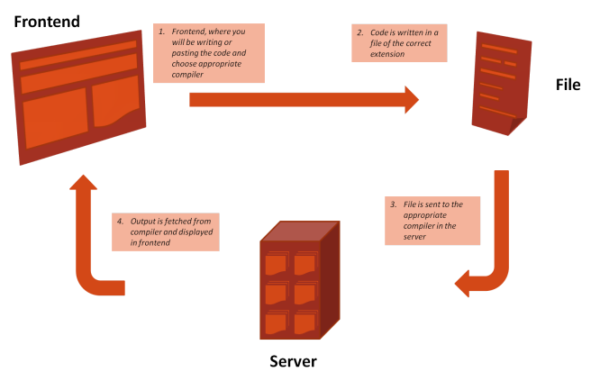
Methodology Proposed/ Design
manifest.json
Html
Css
Java Script
Fig. 1 Working Model of chrome extension for dropdown code editor

Slide 6
Technologies / Tools Used
HTML
CSS3 + Bootstrap
JavaScript
Manifest.JSON
Ace Editor

Slide 7
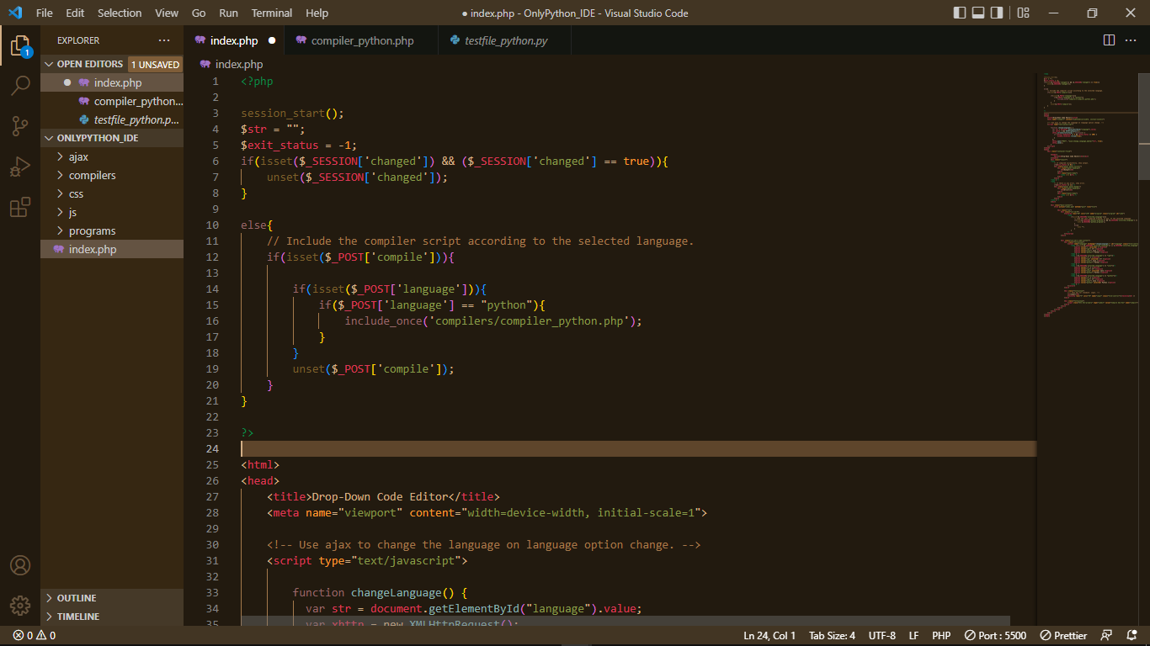
Implementation of Modules with codes
Frontend
index.php
Fig. 2 Frontend part of the working model

Slide 8
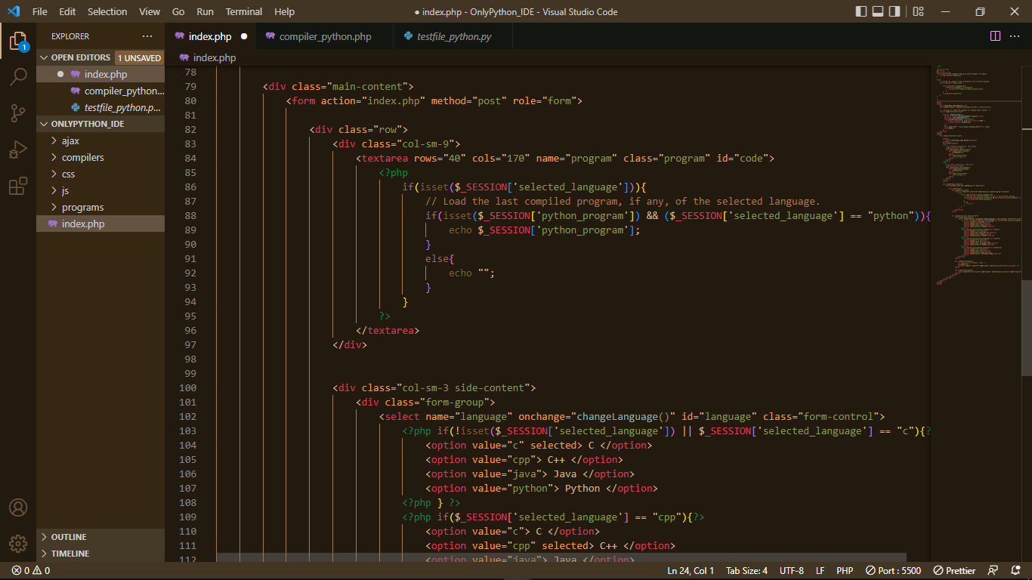
Fig. 3 Continuation of figure 2

Slide 9
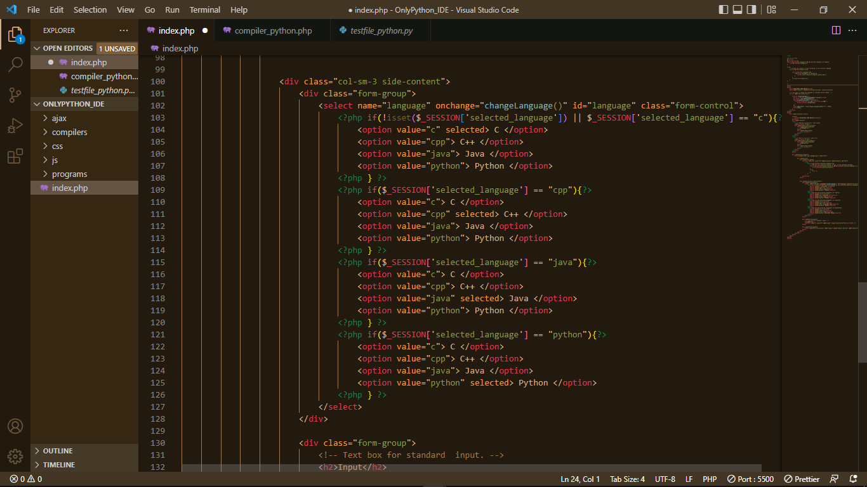
Fig. 4 Continuation of figure 3

Slide 10
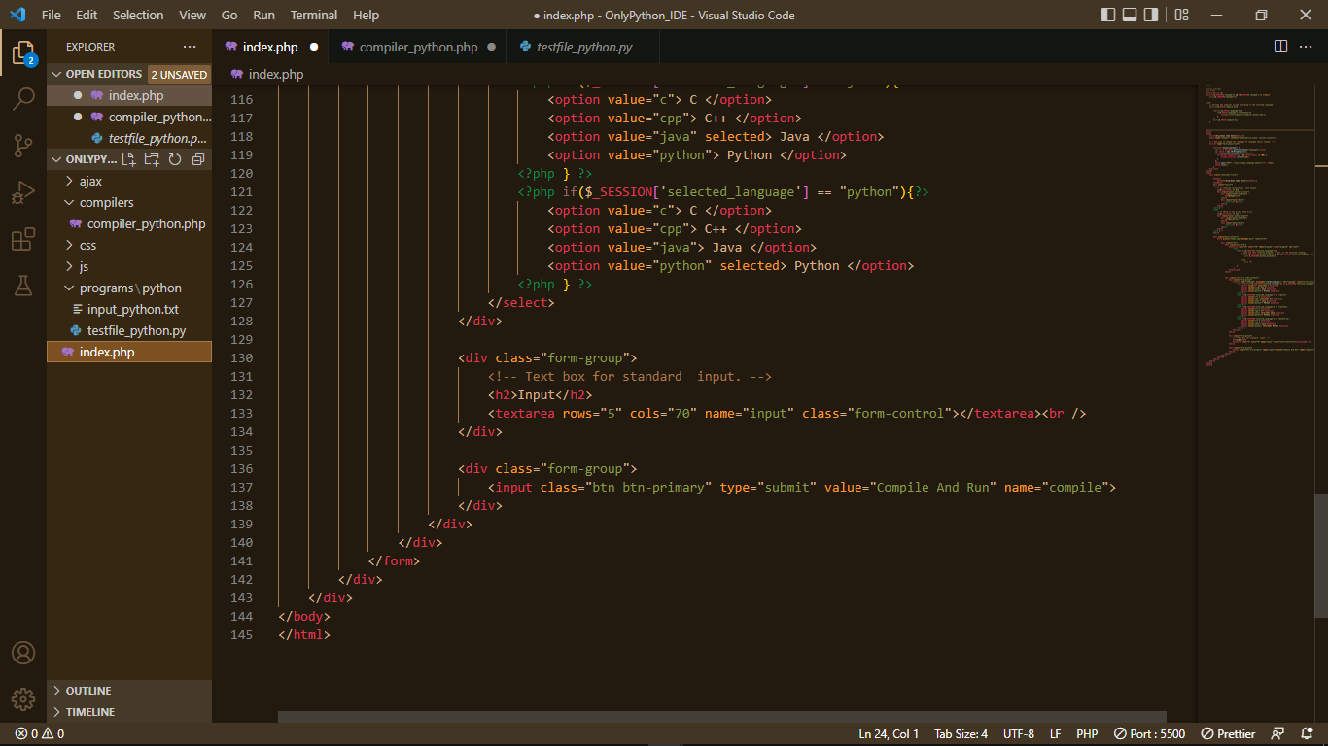
Fig. 5 Continuation of figure 4

Slide 11
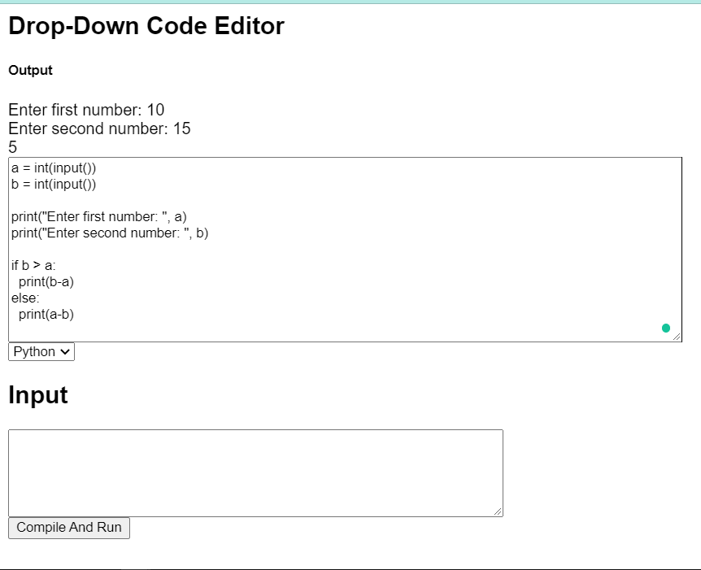
Results
Fig. 6 Implementation of the frontend

Slide 12
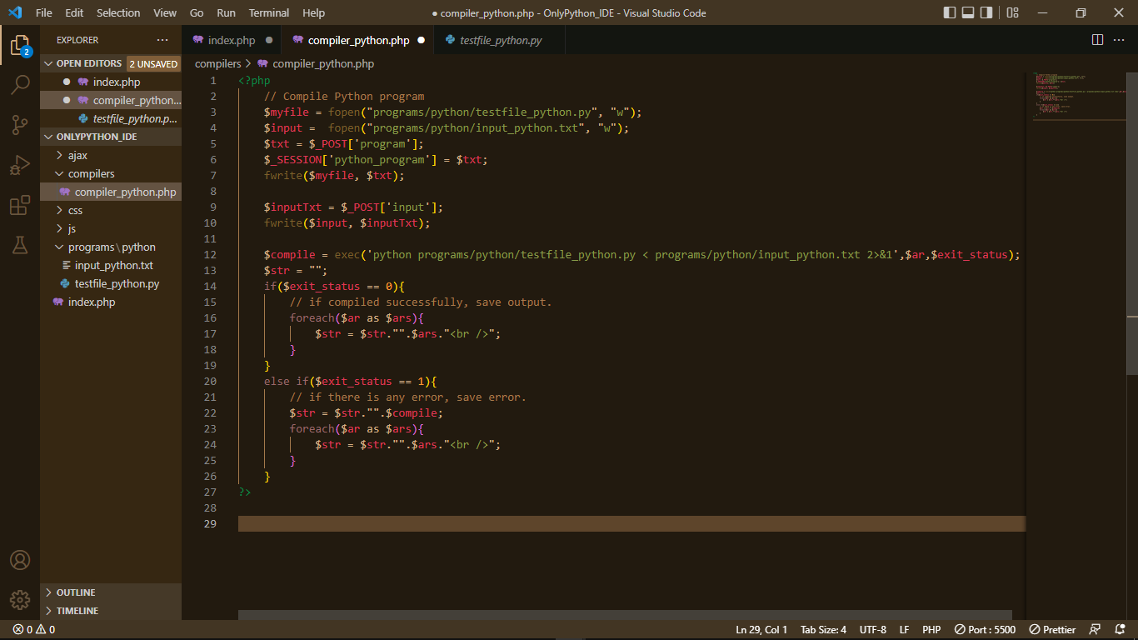
Snapshots
Fig. 7 Compiler file

Slide 13
References
Journal Papers:
[1] Muhammad Nomani Kabir, Omar Tayan, Yasser Alginahi, “On the development of a web extension for text authentication on Google Chrome”, 2019 International Conference on Electrical, Computer and Communication Engineering (ECCE), 7-9 February 2019.
[2] Arjun Dattal, Amab Kumar Paue, “Online Compiler as a Cloud Service” IEEE International Conference on Advanced Communication Control and Computing Technologies (ICACCCT), 2014.
[3] Sejal Atul Kadam, Verma Yashika Anil, Shaikh Anam Parvez, Sayali Avinash Bhavsar, “Hybrid Smart Compiler Using Cloud Computing” Information Technology: Nashik District Maratha Vidya Prasarak Samaj’s Karmaveer Adv. Baburao Ganpatrao Thakare College of Engineering, Nashik, India, JETIR May 2019, Volume 6, Issue 5.
Website:
https://www.w3schools.com/js/js_json_php.asp
https://stackoverflow.com/questions/67516388/how-to-run-a-python-file-using-exec-function-in-php

Slide 14
Thank You

